Slide 1


Deepening Learning:
Clarity of Learning Goals
Team 1
Post University
EDU609

Slide 2

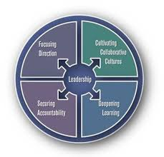
Fullan’s Coherence Framework Categories
Focussing Direction
Cultivating Collaborative Cultures
Deepening Learning
Securing Accountability

Slide 3
Laying the groundwork for Deepening Learning...
Focussing Direction
Leadership changes within a district/classroom.
Learning is based off of a purpose, or the reason behind why one is learning the topic.
Goal setting between the instructor and students and how it can be used throughout a lesson (Fullan, 2016).
Cultivating Collaborative Culture
The idea in which it takes a group to provide adequate instruction (Fullan & Quinn, 2016)
When groups of staff blend their ideas, staff work off each other’s thoughts to help build a new lesson on a topic.

Slide 4


Focusing Direction:
Diving deep into what one should be learning through goals.
Producing leadership roles to implement lesson plans.
Allowing all leaders throughout a district have a say in the lesson planning.

Slide 5
Our Idea On Focusing Direction
A previously written curriculum was made by a principal. With the curriculum in mind the teacher then takes the ideas on how to make the children successful. She implements her own developed fraction lesson plans while keeping in mind the goal set for them or the answer to why we are instructing this lesson and what do we expect our students to develop knowledge on.

Slide 6
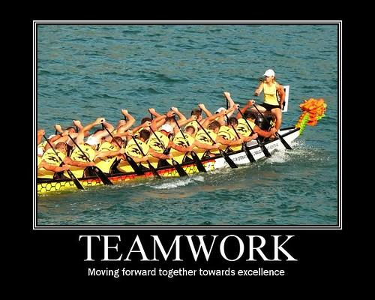
Example of Cultivating Collaborative Culture
A fourth-grade math teacher is creating a lesson on equivalent fractions, she is showing the students a worksheet representation. The class seems to be more hands on, a coworker comes up with the idea of using fraction pieces out of construction paper to help her find a new form of teaching using more of a hands-on approach.

Slide 7
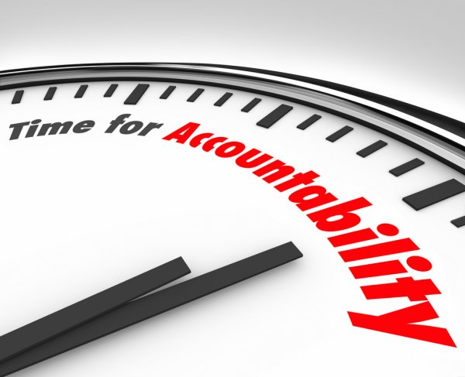
Securing Accountability:
Motivation is the key in success.
Keeping an optimistic train of thought will help through both external and internal accountability in order thrive.
External accountability is based off administration motivation.
Internal accountability is the opportunity to base one’s actions and thoughts for motivation.

Slide 8
What are the differences between the two accountabilities?
Internal Accountability:
The art of one’s own inspiration and motivation.
External Accountability:
Directions and motivation coming from others in a set formal position such as a principal, or administration
Example:
The fourth-grade teachers inspired herself to produce a very thought-out lesson, with use of one’s own creativity, using less district provided worksheets, instead with their own thoughts, such as the visual lesson on fractions.
Example:
A principal in charge of the fourth-grade class spoken about has provided the team with a set of lessons and encourages the teacher to use their own creativity to build a lesson based on the goal of succession in the class.

Slide 9
Drivers are not just someone behind the wheel.
You can also have right and wrong drivers when securing accountability:
Right driver: The skill and tools that will be supplied in order adequately achieve the goal of succession within the classroom.
Wrong driver: Where the skills to complete your goals are affected in a negative way in which a goal is not completed.
Actions of a driver include:
Teamwork or inspiration
Motivation of all individuals in a classroom
Chance of improvement within the classroom
(Fullan,2014)

Slide 10
What do the words Deepening Learning mean?
According to Fullan,
“Deepening learning is the act in which an explanation of a lesson is acknowledged in a way which allows the students to understand the lesson through knowledge, instruction, and importance.”
Providing students with the tools before the assignment to understand what their expected to learn.
With prior knowledge on what is expected this can set the student up for a positive outcome of the lesson.
Using clarifications on their learning, we believe you can see a larger number of students succeeding due to prior knowledge of what we expect the individual to get out of our lesson.

Slide 11

How do we deepen our learning goals?
We can provide our students with daily learning targets, here the students will be provided with the information on what we expect them to lean. That same math teacher created a learning target for her equivalent fractions lesson, while being introduced, she explained not only what they were doing for directions but also the why they were working on these fractions. When the lesson started the students were already made aware of what they were expected to accomplish and how they would go about this goal through her lesson.

Slide 12
Clarity of Learning Goals
“The first step in building precision and consistent practices is to be clear about the learning goals” (Quinn, 2015, p. 83).

Slide 13






The 6 C’s of Next Generation Learning:
Communication
Tailoring communication to a range of audiences through different modalities.
Critical Thinking
Critically evaluating information and applying it to real world applications.
Collaboration
Capacity to work together to contribute the to learning of others using strong interpersonal skills.
Creativity
Asking the right questions to generate new ideas and demonstrating leadership to put those ideas into practice.
Character
Qualities that are essential for the individual to be effective showcasing grit, perseverance, and responsibility.
Citizenship
Thinking of global issues to engage with others to solve complex problems.

Slide 14
1.
Communication
Building Relationships
Identifying Learning Goals
Student Development
Embrace Individuality

Slide 15
2.
Critical Thinking
Real World Application
Improve Student Engagement
Challenge Conventional Thinking
Evoke Passion

Slide 16
3.
Collaboration
Eliminate Instructional Discrepancies
Reduce Workload
Share Best Practices
Professional Development Utilization

Slide 17
4.
Creativity
Increase Participation
Incorporate Different Learning Styles
Employ Cultural Diversity
Moving/Centers/Rotations

Slide 18
5.
Character
Creating Meaningful Relationships
Emotional Intelligence
Motivation
Perseverance

Slide 19
6.
Citizenship
Responsibility
Accountability
Human Connection
Environment Awareness

Slide 20
Why is having a clear understanding of this element important to curriculum design work?
It’s helps with understanding
Allows feedback to improve if need be
Sets expectations

Slide 21
How does this element reflect to what is being done in the classroom?
Creating a community of learners
Activating students to be able to lead their own learning
Being able to network beyond the school walls
Personalizing learning

Slide 22
What kind of support would ask of the curriculum coordinator in order to move forward?
Are we able to be provided with the necessary tools to ensure our students can be successful?
Conduct meaningful evaluation, that will help teachers improve if need be.
Offer advice, direction or assistance

Slide 23
What do you anticipate the next steps to be in achieving a school wide commitment to deepen learning?
For everyone to come together in a collaborative way.
For people to be about to acknowledging that there needs to be change.
To be provided with the necessary tools to ensure that deepen learning can occur.

Slide 24
Our Goal: Challenges:
Supply the students with the tools to be prepared for their own knowledge on a topic by giving focus and direction.
Using learning targets can help keep students all at the same pace as some students intake information faster than others.
Fear of overloading students with expectations
Applying confusion on to a topic
Less creativity on students end as they are given the how and why they are using this lesson.

Slide 25
Mission Moving Forward...
Concerns at West Pines:
Parents have expressed concern that the students are not being challenged.
Staff members work independently
Lack attention to critical thinking
Student excitement is not highly evident in their learning experiences.
Teachers are feeling overwhelmed
Changes to better West Pines:
Better Communication
Differentiate learning
Collaborate with Co-workers
Share best practices
Identify goal of lesson
Expand Thinking
Get Excited about learning
Incorporate different learning modalities
Splitting the workload

Slide 26

“A good education is a foundation for a better future.”
-Elizabeth Warren

Slide 27

References
Abelmann, C. & Kenyon, S. (1999). When Accountability Knocks, Will Anyone Answer? https://files.eric.ed.gov/fulltext/ED428463.pdf
Barack, L. (2021). “Clarity Crucial to Support Student Learning Objectives in Remote Education.” K12dive. www.k12dive.com/news/clarity-crucial-to-support-student-learning-objectives-in-remote-education/592752/.
Fullan, M. (2014). Eminent Voices. http://www.youtube.com/watch?v=IEcBF9KPgSg
Fullan, M. (2016). Coherence: Putting Inner Drive To Overdrive. https://www.scoe.org/files/16_Fullan_Coherence_Short_Handout_(1).pdf
Fullan, M. & Quinn, J. (2016). Coherence. https://ambassadored.vitalsource.com/#/books/9781506301723/cfi/6/16!/4/2/12/56/2/8@0:87.1
Gates, G. (2017). Are You Clear On Clarity Of Learning Objectives? http://info.teachstone.com/blog/clarity-of-learning-objectives#:~:text=Basically%2C%20this%20indicator%20means%20that,focusing%20their%20attention%20during%20activities.
Jones, L. (2018). The Power of Teacher Collaboration. Teaching Channel. Retrieved from https://www.teachingchannel.com/blog/teacher-collaboration

Slide 28
Additional References
Barack, L. (2021). “Clarity Crucial to Support Student Learning Objectives in Remote Education.” K12dive. www.k12dive.com/news/clarity-crucial-to-support-student-learning-objectives-in-remote-education/592752/.
Skoolar (2018). The 6cs Of Education. https://skooler.com/the-6-cs-of-education/
Theirs, N. (2017). Making Progress Possible: A Conversation With Michael Fullan. http://eds.a.ebscohost.com.postu.idm.oclc.org/eds/pdfviewer/pdfviewer?vid=8&sid=45052eb1-7f76-463f-8730-ec550e406460%40sdc-v-sessmgr01

